Slide 1

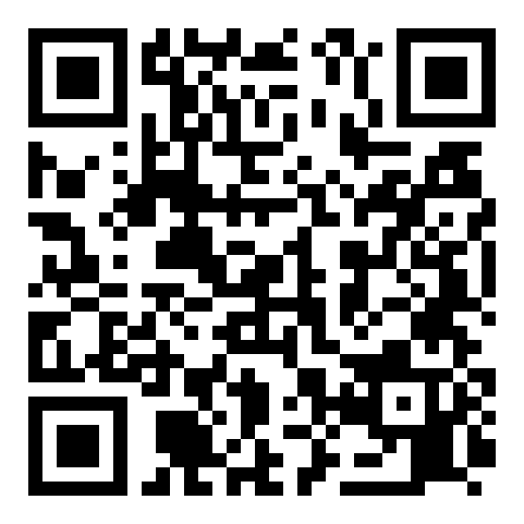
ORGANIZATIONAL TRUST QUOTIENT®
Reading team health
from everyday messages
How people talk at work → a signal of how the team is doing
Scan to request a briefing
Vernon T. Cox · Srilatha Alla
CNM Ingenuity — Data Science Bootcamp Capstone
Instructor: Robert Citek
SME: Prof. R. DelCampo — UNM Anderson
Notes:
Hi, I'm Vernon Cox, with Srilatha Alla. Our project asks a simple question: can the way a team communicates tell us how healthy the team is? We read everyday message patterns — not the words — and turn them into a signal. The QR code opens our notebook runnable in Colab. About 30 seconds.

Slide 2





PREVIEW — WHAT WE'LL COVER
The next 10 minutes
Scan · Request a briefing
1
The problem we set out to solve
2
What OTQ looks at
3
The data — and how we score it
4
Results & the dashboard we built
5
Take-homes & what's next
02
Notes:
Tell 'em what we're gonna tell 'em. Five beats: the problem, what we look at, the data plus our scoring, results and the dashboard, then take-homes and next steps. 20 seconds.

Slide 3

THE BUSINESS PROBLEM
Unfocused, disjointed, unheard teams cost time and money
Scan · Request a briefing
+
+
PULLED APART
WALLED OFF
TUNED OUT
Unfocused
Disjointed
Unheard
effort scatters, priorities blur
work duplicated, handoffs dropped
concerns surface too late
The cost: Across every company this quietly drains hours, slows delivery, and pushes good people out — real money leaders rarely see.
03

Slide 4

THE PROBLEM
Trust is hard to see — until it's gone
Scan · Request a briefing
The usual way: periodic surveys
DAYS BETWEEN CHECK-INS
30–365
Annual, quarterly, pulse, 360° — methods & timing vary
People answer how they “should”
Takes time away from work
Teams send thousands of
messages a day — unused
Our goal: an always-on read — with no extra work
04
Notes:
The problem in plain terms. Trust decides whether people speak up early or share half-finished ideas. But we usually only check once a year, with a survey that's slow, biased, and disruptive. Meanwhile teams already produce thousands of signals a day. Our goal: use those, with no extra work.

Slide 5
WHAT OTQ LOOKS AT
From “how people talk” to “how the team is doing”
Scan · Request a briefing
→
→
WE MEASURE
WE PREDICT
WE'RE AFTER
Engagement
Responsiveness
Trust
how much people talk & meet
how fast they reply
the thing underneath — inferred
Being honest: we measure talk and predict replies. Trust is what we believe sits underneath — we don't claim to measure it directly.
05
Notes:
What we actually look at — and our reviewer's key point. We measure engagement (how much people talk and meet), we predict responsiveness (how fast they reply), and trust is the thing underneath that we're really after. We're careful not to overclaim: we don't say we measure trust directly.

Slide 6





THE DATA · WHERE IT COMES FROM
Three everyday tools, one combined table
Scan · Request a briefing
→
Slack
Teams
Outlook
1,250 events
in one table
500 chat messages
400 meetings
350 calendar invites
Practice data: the “Apostles” dataset
No real company yet — so we built safe stand-in data from Bible figures (the apostles). Same shape as real Slack / Teams / Outlook exports, so the code is ready for the real thing.
06
Notes:
Where the data comes from. We pull from the three tools people already use — Slack, Teams, Outlook — and merge them into one table of 106 events. Since we don't have a real company's data yet, we built safe practice data from Bible figures, the apostles, in exactly the same format a real export would have.

Slide 7

THE DATA · WHAT'S IN IT
Each row is one interaction — counts, not words
Scan · Request a briefing
Source | Type | Who | Channel | Min | People | Score
Teams | meeting | Peter | council | 60 | 12 | 30.9
Slack | chat | Paul | epistles | 0 | 2 | 11.0
Outlook | meeting | James | assembly | 90 | 8 | 30.5
Slack | chat | John | acts | 0 | 4 | 12.5
What we keep
Who & where
How long
How many people
A reply-speed clue
Sample rows from the combined table. Names/channels are labels in the data — never message content.
1,250
3
8
events
sources
fields each
07
Notes:
This is the heart of the data. Each row is a single interaction with a few plain facts: which tool, what type, who, where, how long, how many people, and a reply-speed clue. Crucially, we keep counts and timing — never the contents of any message. 106 events, 3 sources, about 8 fields each.

Slide 8

THE DATA · HOW WE SCORE IT
Give every interaction a score
Scan · Request a briefing
Bigger score = more engagement. Meetings count more than emails; longer and more people count more.
Score one event
Start: type of interaction
Add: how long it ran
Add: how many people
Add up each day
Total score & # of events
Avg people & length
How much was written
08
Notes:
How we turn interactions into numbers. Every event gets an engagement score: start with the type — meetings count most, email least — then add a little for how long it ran and how many people were involved. Then we add everything up per day to get daily team numbers. All the rules are simple and visible.

Slide 9
UNDER THE HOOD · THE CODE
From rule to score, in real code
Scan · Request a briefing
otq_scoring.py
fit_model.py
def otq_event_units(event_type, duration, people):
t = event_type.lower()
if "meeting" in t: base = 24.5 # weighs most
elif "chat" in t: base = 9.5
elif "call" in t: base = 8.5
elif "email" in t: base = 6.0
else: base = 5.0
dur = min(duration, 120) / 60.0 # +0 to 2
reach = log(max(people,1), 2) * 1.5
return base + dur + reach
features = ["log_total_eu",
"log_total_events", "avg_participants",
"avg_duration", "log_total_text"]
# alpha tuned by GridSearchCV (5-fold)
model = Ridge(alpha=best_alpha)
model.fit(X_train, y_train)
r2 = r2_score(y_test, model.predict(X_test))
# negative coef -> more talk, faster reply
09
Notes:
A quick peek under the hood. On the left, the scoring rule we just described, exactly as it runs: a base by type, a small duration bonus, and a log-scaled reach. On the right, the model: five daily features, a Ridge regression with its strength tuned by grid search, then we score it on days it never saw. You can scan the QR to run all of it.

Slide 10
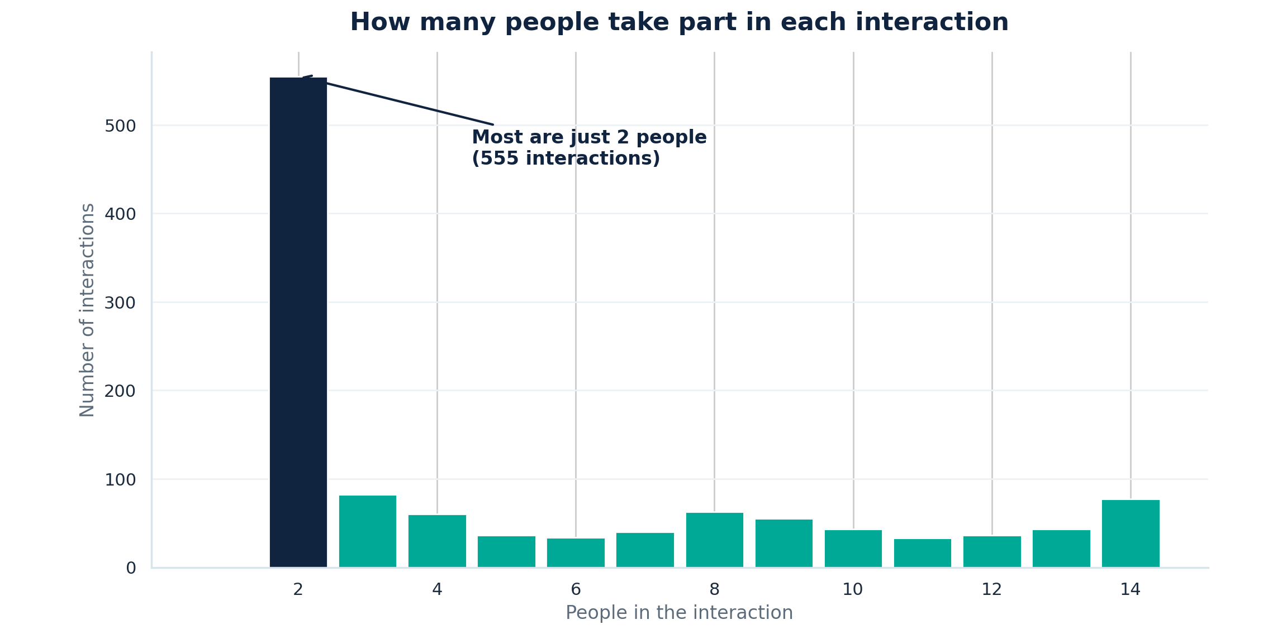
THE DATA · A FIRST LOOK
What the real numbers look like
Scan · Request a briefing
A first look at the data: most interactions are quick one-to-one exchanges, with larger group meetings making up the tail.
10
Notes:
This is the real exploratory view from the notebook. Most events are short chats with a couple of people; meetings are rarer but score much higher. The bottom-right panel is the one to watch — total daily engagement against response time — which is the relationship the model goes on to learn.

Slide 11


THE MODEL
A steady model that connects the dots
Scan · Request a briefing
What it does
How we checked it
Learns: engagement → reply speed
Our clues overlap — needs to stay steady
Ridge regression keeps it stable & readable
Compared against other models
Tuned the settings carefully
Tested on days it never saw
Ranked which clues matter most
11
Notes:
Our model in plain terms. It learns the link between engagement and reply speed. Because our clues overlap a lot, we used Ridge regression — a model built to stay steady and stay readable when that happens. And we didn't trust one run: we compared other models, tuned settings, tested on days it had never seen, and ranked which clues mattered most.

Slide 12



WHAT WE BUILT
A website that runs the whole thing
Scan · Request a briefing
organizationaltrustquotient.com
Upload the files
It runs everything for you
Client data
See results & charts
We connect to your data source first — then OTQ delivers your team’s day-by-day predictions.
Day-by-day predictions
12
Notes:
What we built beyond the notebook: a simple website. You drop in the files, it runs the whole pipeline for you, and the results and charts come right back — including day-by-day predictions. Someone with no coding background can use it.

Slide 13
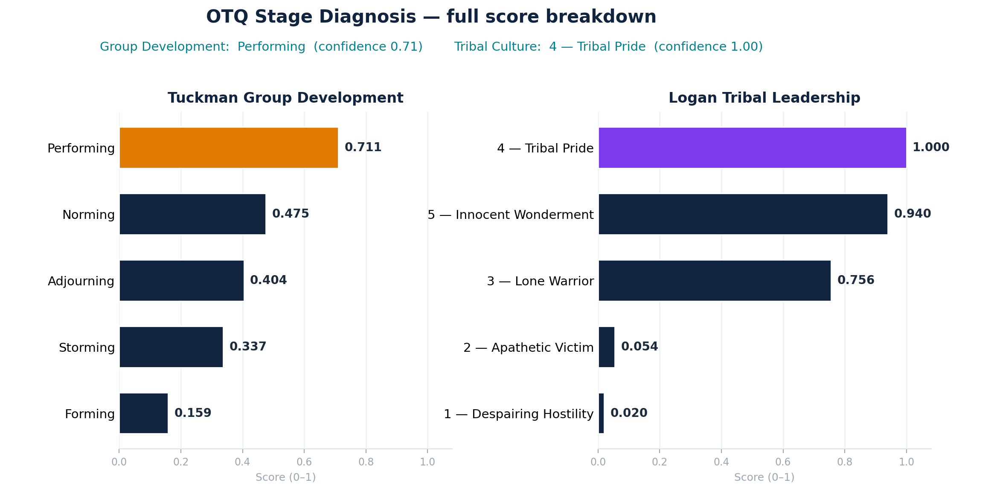
STAGE DIAGNOSIS · FULL BREAKDOWN
Every stage, scored
Scan · Request a briefing
Full Tuckman and Logan scores, ranked. An engagement-based indicator for discussion — not a validated team-development or culture diagnosis.
13

Slide 14
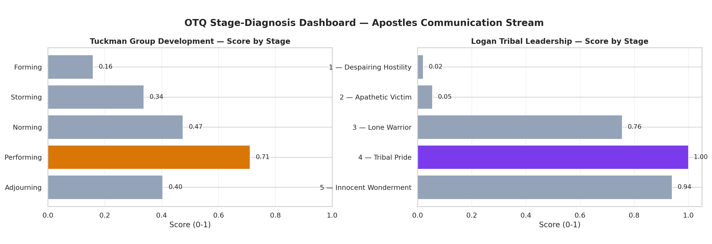
BEYOND RESPONSIVENESS · STAGE SIGNAL
Where the team sits — by stage
Scan · Request a briefing
OTQ maps the same engagement patterns onto two team-stage frameworks (Tuckman & Logan). An indicative signal to discuss — not a validated team-development or culture diagnosis.
14

Slide 15
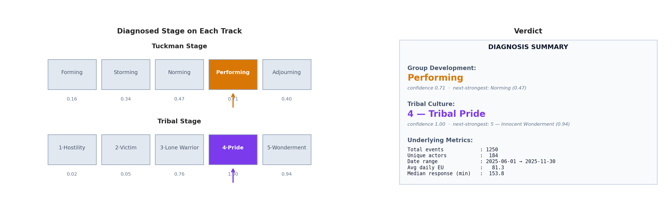
THE VERDICT
The stage read, in one view
Scan · Request a briefing
Diagnosed stage on each track with a confidence score, plus the underlying metrics (1,250 events · 184 actors · Jun–Nov 2025). An engagement-based indicator, not a clinical assessment.
15

Slide 16

TAKE-HOME POINTS
What to remember
Scan · Request a briefing
Always-on beats once a year
Talk predicts replies
a live read, not an annual survey
more engaged teams answer faster
We're honest about it
Private by design
we measure talk, not trust itself — yet
counts & timing only, no message content
16
Notes:
Tell 'em what you told 'em. Four take-homes: always-on beats once a year; how people talk predicts how fast they reply; we're honest that we measure talk, not trust itself yet; and it's private by design — counts and timing only, never message content. If they remember one slide, this is it.

Slide 17


WHAT'S NEXT
Next steps & questions
Where we go from here
Questions?
Check our score against a trusted trust survey
Use a real company's data
Give each team & person their own score
Track real outcomes (deadlines, tickets)
Vernon T. Cox · Srilatha Alla
Instructor: Robert Citek — CNM Ingenuity
SME: Prof. R. DelCampo — UNM Anderson
Scan to request a briefing
17
Notes:
What's next and questions. The big next step is checking our score against a trusted, validated trust survey on a real team — that's what would let us truly say 'trust.' Then real company data, scores per team and person, and tracking real outcomes. The QR code opens the notebook in Colab. Thank the instructor and SME, and open the floor.

